Slide 1
MCU’s Garage
I2C
Inter-Integrated Circuit

Slide 2
Index
Major Features of I2C
Pros / Cons of I2C
Physical Layer of I2C
Timing Diagram
MCU’s Garage

Slide 3
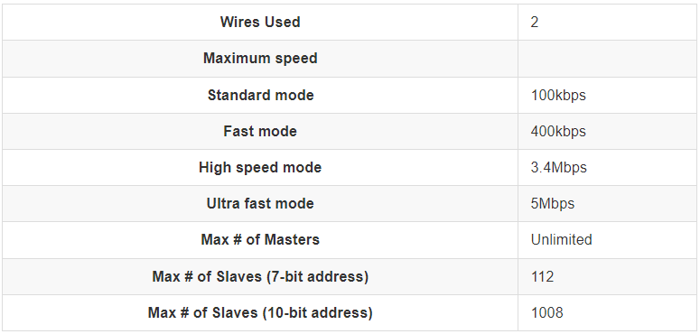
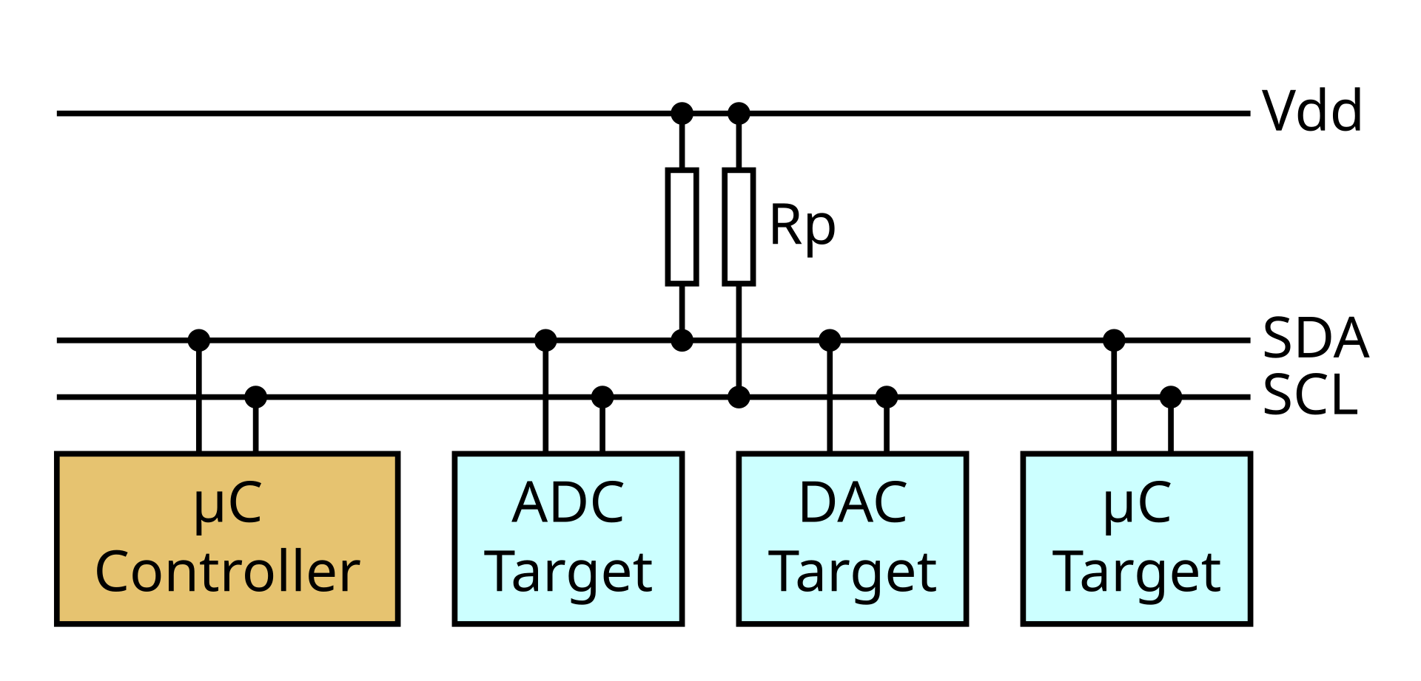
Major Feature of I2C
I2C is a synchronous, multi-controller/multi-target serial communication bus
Communicates with SDA(Data Signal) & SCL(Clock Signal)
With 7bit Address space, can connect 112 nodes in theory
With 10bit extended Address space, can connect 1008 nodes in theory
Used in sensors, OLED, LCD controller, DAC ADC Devices, EEPROM .... etc

Slide 4
Major Feature of I2C
There are several modes of operation for I2C communication
Standard mode : 100 kbit/s, All I2C device should support Standard mode
Fast mode : Achieved 400 kbit/s speed by adjusting several timing parameters
Fast mode plus: Achieved up to 1 Mbit/s by using more powerful (20 mA) drivers and pull-up
High speed mode : Achieved up to 3.4 Mbit/s, but have some constraints like requiring to have a clock line with active pull-ups during high-speed transmission
Ultra fast mode : 5Mbit/s Write only I2C mode , always keeping the data line in active state. Also clock stretching, arbitration, read transfer and ACK are all omitted
Standard 100kbit/s
Fast mode
400kbit/s
Fast mode plus
1Mbit/s
High speed mode
3.4Mbit/s
Ultra fast mode
5Mbit/s
Slower
Faster

Slide 5
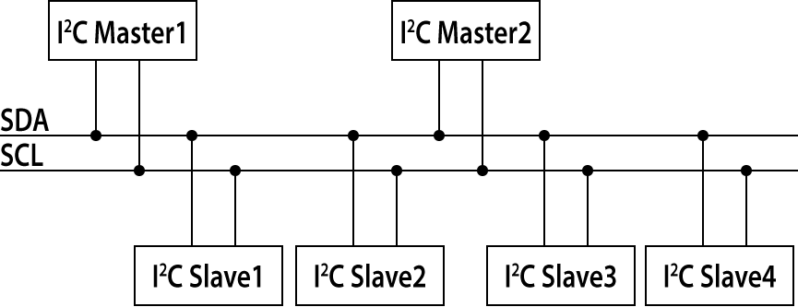
Pros and Cons
I2C communication protocol has the following Pros
The bus can be configured with two Data communication lines: SDA and SCL
Operates as synchronous communication, enabling stable communication
Multiple I2C masters and multiple I2C slave devices can be connected in a single bus.
Can add or Remove I2C device while bus is active

Slide 6
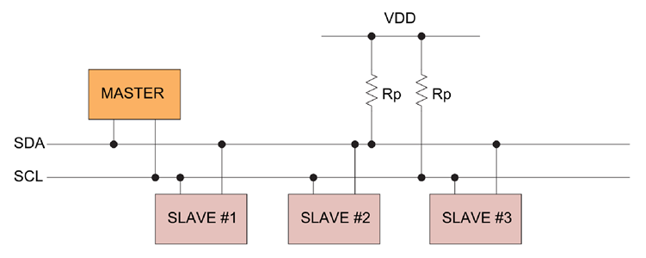
Pros and Cons
I2C communication protocol has the following Cons
Slow speed, Since Faster than UART, but slower than SPI, It’s often an ambiguous option.
Since Half-Duplex communication, Only just one node can transmit data.
Order and configuration of data bits(control register, device address, etc) must be considered in various aspects
Should add pull-up register, in each SDA, SCL.

Slide 7
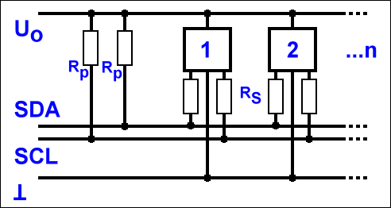
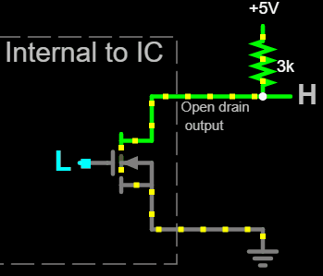
Physical Layer
SCL and SDA lines require pull-up resistance for each line as an open drain (MOSFET) or open collector (BJT) bus design.
- Open drain has the following characteristics
Using MOSFET(Metal-Oxide-Semiconductor Field-Effect Transistor), Drain terminal is connected with external circuit
When MOSFET is activated, drain terminal is connected to GND (Output LOW)
When MOSFET is deactivated, drain terminal become high impedance state since external pull-up resistor(Output High)
Used on low power consumption, high-speed switching is required field(I2C, GPIO)

Slide 8
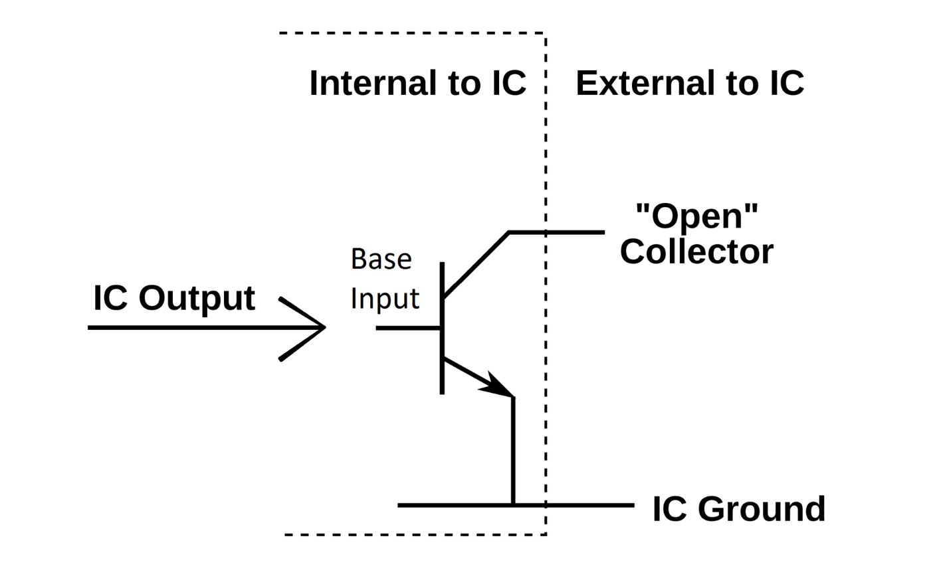
Physical Layer
Open collectors have the following characteristics
Using BJT (Bipolar Junction Transistor), Collector terminal of the BJT is connected to an external circuit
When BJT is activated, collector terminal is connected to GND (Output LOW)
When BJT is deactivated, collector terminal become high impedance state since external pull-up resistor (Output High)
Used mainly when relatively high current is required (Transistor-Transistor Logic (TTL) circuits, relay control, etc)
In general, open drain and open collector operate in the same way with a default High and active Low configuration.

Slide 9
Thank you
MCU’s Garage

